Slide 1
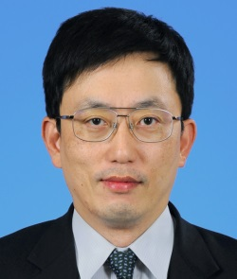
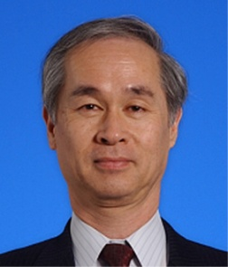
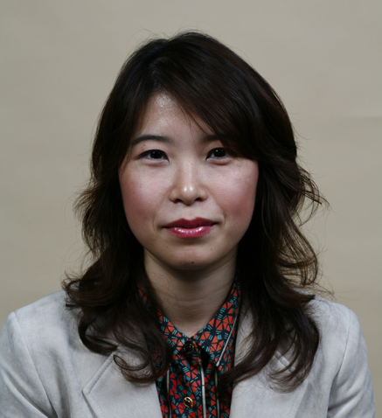
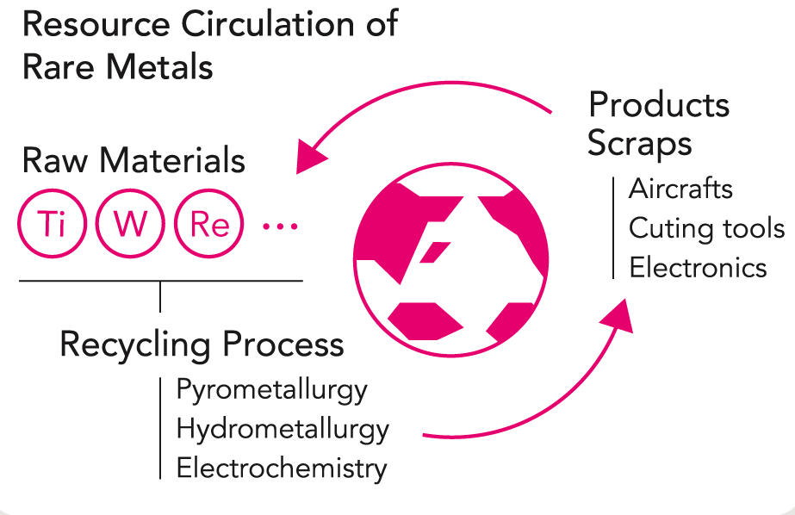
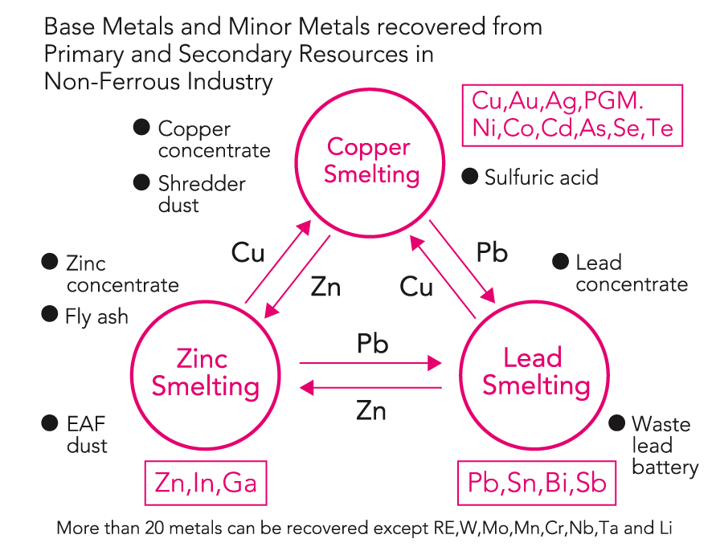
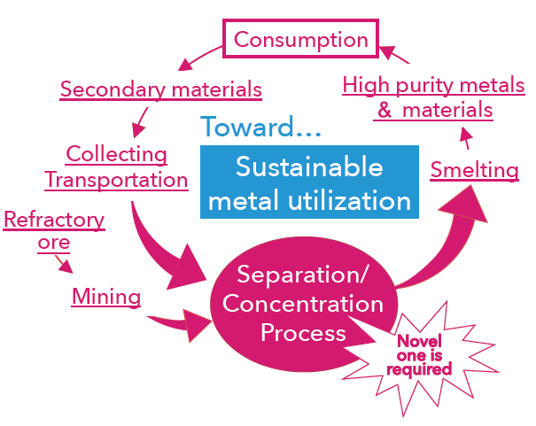
RECYCLING FOR NON-FERROUS METALS AND RARE METALS
Fw-401
Endowed Research Unit for
Non-ferrous Metals Resource Recovery Engineering
(JX Metals Endowed Unit)
[ Towards Highly Sustainable Society ]
Institute of Industrial Science, Endowed Chairs
Non-ferrous Metals Resource Recovery Engineering
http://www.metals-recycling.iis.u-tokyo.ac.jp/
Industry-University Collaboration Center
to Develop New Recycling Processes for Metals
Sponsor: JX Nippon Mining & Metals Corporation
[ Period ]
1st period: January 2012 to December 2017（5 years）
2nd period: January 2017 to December 2021（5 years）
Recycling of valuable materials is essential for the sustainable growth of a society. High-quality natural resources are getting depleted, and resource nationalism is rising in countries that are rich in natural resources. Therefore, it is very important for the Japanese society to promote recycling of rare metals and base metals.
This unit develops environmentally friendly processes for recycling based on smelting and refining technologies for nonferrous metals. Furthermore, it aims to train young researchers and engineers in collaboration with industrial sectors in this field.
In order to expand the activities of the unit further after five years in the first term, the second term began in January 2017, with the inclusion of Prof. Chiharu Tokoro as a new member.
In the second term, this unit will not only further develop the activities undertaken in the first term but also intensify activities to raise awareness of the importance of this field to the general public, especially women and young children (below high-school age).
Research Group
Project Prof.
Toru H. Okabe
Project Prof.
Takashi Nakamura
Project Prof.
Chiharu Tokoro
Director Professor,
Integrated Research Center for
Sustainable Energy and Materials,
Institute of Industrial Science, The University of Tokyo
Emeritus Professor,
Tohoku University
Professor,
Faculty of Science and Engineering,
Waseda University
Development of Efficient Recycling
Technologies for Rare Metals
Metal Recycling Based on the New Concept of “Artificial Deposit”
Development of Separation and
Concentration Technology to Utilize Waste/Refractory Ore as “Resource”
Our laboratory is developing new, efficient and environmentally sound processes to recycle rare metals for which an increase in demand is expected, such as titanium, tungsten, cobalt, rhenium and platinum group metals.
A new concept of "artificial deposit" is proposed. An urban mine has been developed solely on the basis of economic rationality. The wastes, which contain valuable metals that are currently non-recyclable, are reserved as artificial deposits in the proposed system.
In our laboratory, solid / solid separation and concentration technology without heating / dissolving the waste or refractory ore is studied to achieve an energy-saving separation and concentration process. This process is regarded as “pre-treatment” or “middle treatment” before metallurgical / hydrometallurgical process, which produces high-purity metal.

