Slide 1
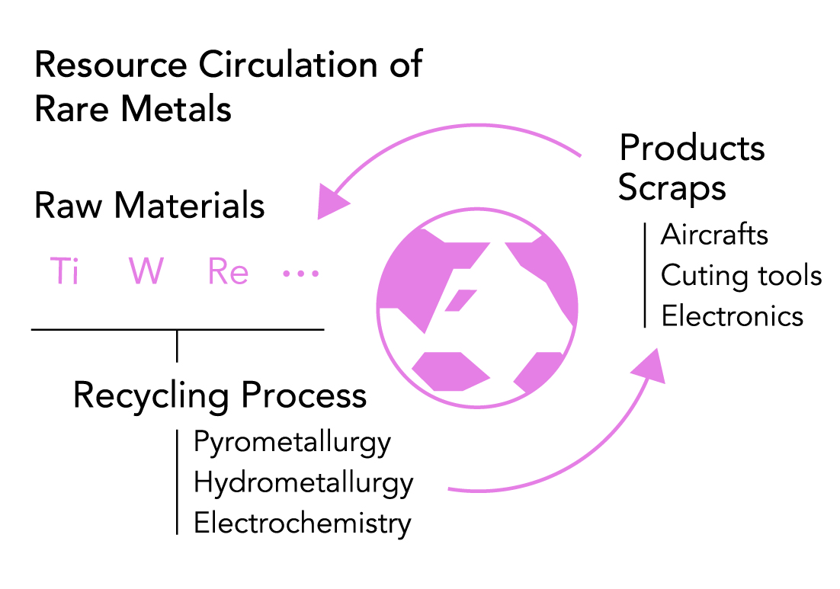
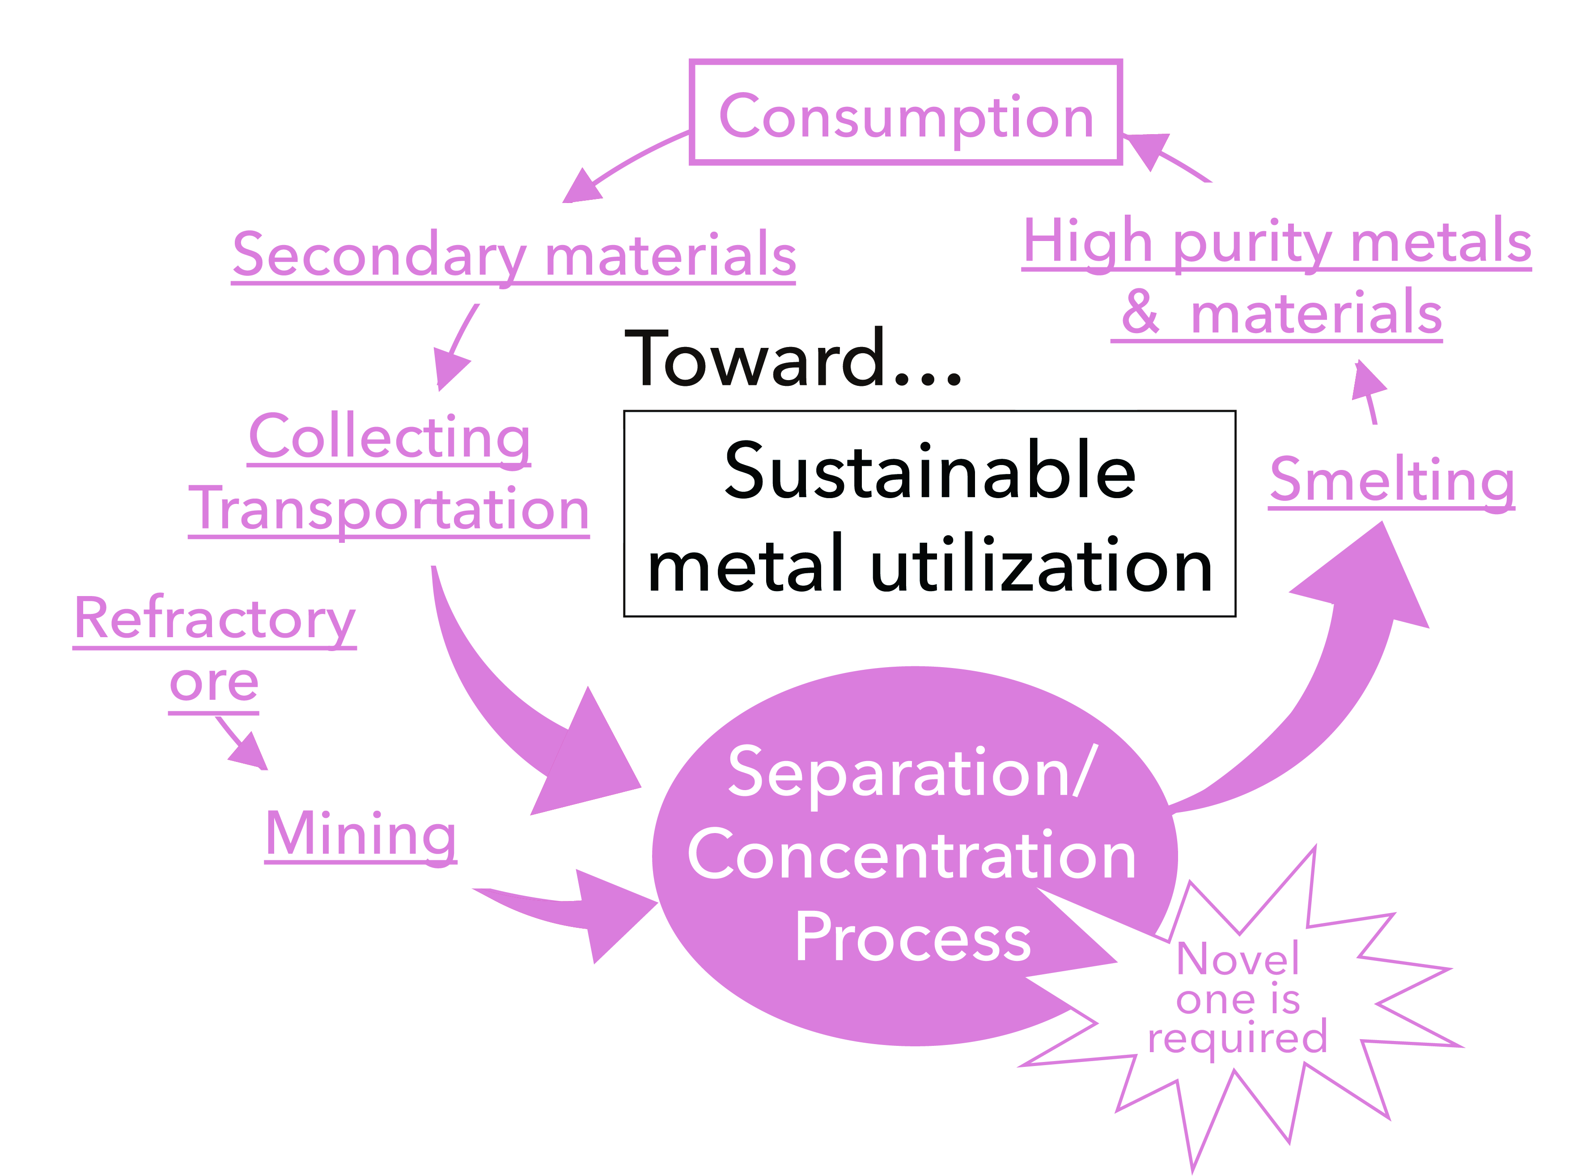
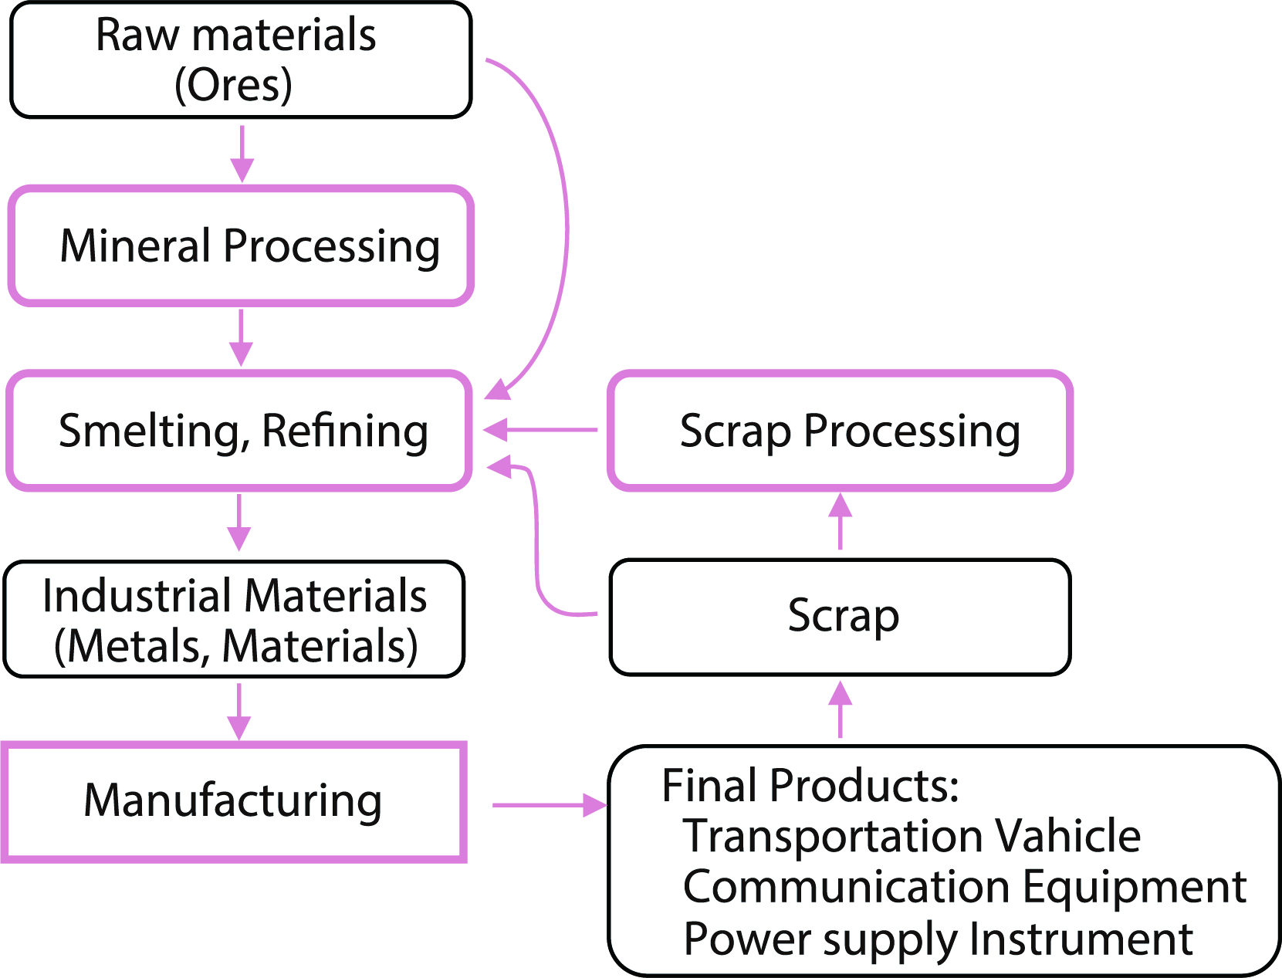
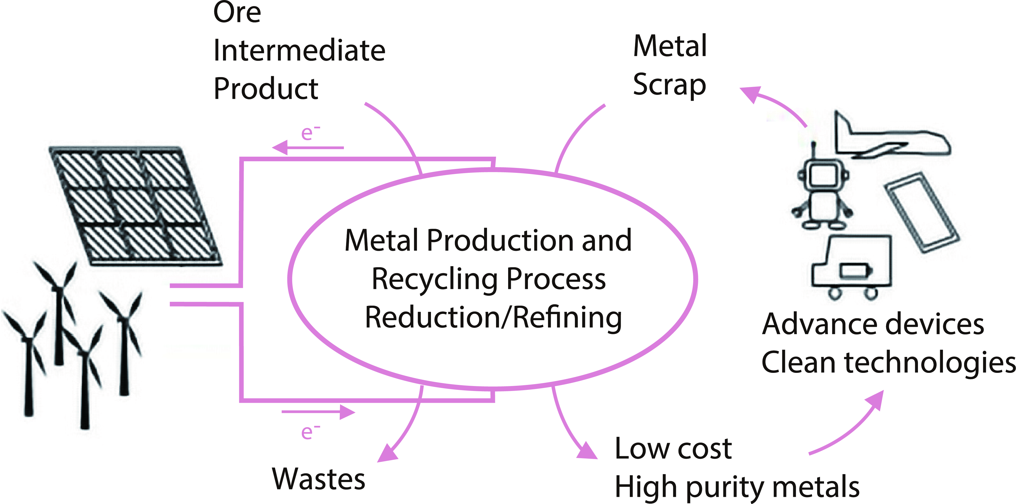
Recycling for Non-ferrous Metals and Rare Metals
Fw-401
Endowed Research Unit for
Non-ferrous Metals Resource Recovery Engineering
(JX Metals Endowed Unit)
[ Towards Highly Sustainable Society ]
Institute of Industrial Science, Endowed Chairs
Non-ferrous Metals Resource Recovery Engineering
http://www.metals-recycling.iis.u-tokyo.ac.jp/
Industry–University Collaboration Center
for Developing New Metal Recycling Processes
Sponsor: JX Nippon Mining & Metals Corporation
[ Period ]
1st period: January 2012 to December 2016 (5 years)
2nd period: January 2017 to December 2021 (5 years)
3rd period: January 2022 to December 2026 (5 years)
Recycling valuable materials is crucial for sustainable development. High-quality natural resources are depleting, and resource nationalism is intensifying in countries that own abundant natural resources. Therefore, it is imperative for the Japanese society to promote the recycling of rare metals and base metals.
This unit develops environmentally-sound processes for recycling based on smelting and refining technologies for non-ferrous metals. Furthermore, in collaboration with industrial sectors, this unit aims at training young researchers and engineers belonging to this field.
In the second period, this unit advanced and strengthened the activities undertaken in the first period and spread awareness about the significance of this field among the general public, especially young generation (under high-school age) and their parents.
Lecturer Takanari Ouchi and Prof. Tomoko Sugano joined the unit in August 2021 and January 2022, respectively.
In the third period starting from January 2022, in addition to the past activities, we are developing newer activities focusing on SDGs and STEAM education.
Research Group
Development of Efficient Recycling Technologies for Rare Metals
Development of Separation and
Concentration Technology to Utilize Waste/Refractory Ore as “Resource”
Developing Non-ferrous Metal Production Processes
Project Prof.
Toru H. Okabe
Project Prof.
Chiharu Tokoro
Project Prof.
Harumasa
Kurokawa
Okabe Laboratory is developing new, efficient, and environmentally-sound processes to recycle rare metals such as titanium, tungsten, cobalt, rhenium, and platinum group metals because an increase in the demand of these metals is expected in future.
Tokoro Laboratory explores solid–solid separation and concentration technology without heating or dissolving the waste or refractory ore to achieve an energy-efficient process. This process is considered “pre-treatment” or “middle treatment” performed before the metallurgical/hydrometallurgical process that produces high-purity metals.
Kurokawa Laboratory develops energy-efficient, environmentally-sound, and economical process schemes to produce various non-ferrous metals. As compared to the conventional processes, these processes can minimize energy consumption, maximize recovery ratio of target metals, and reduce the amount of waste generated.
Development of a better future society by creating new value from intellectual property (IP)
Highly efficient metal production and recycling processes
Project Prof.
Tomoko Sugano
Project Lecturer
Takanari Ouchi
IP is the key to implementing technologies and ideas into society. Sugano Laboratory takes the perspective of IP in advanced research and considers how to protect IP for social implementation. We create new opportunities for collaborative creation based on IP. IP connects many people, builds new knowledge, creates new places, and develops a better future society.
Ouchi Laboratory is engaged in research and development of new smelting and recycling processes for nonferrous metals and aims to achieve "highly efficient use of energy and resource recycling." We contribute to the development of advanced technologies by efficiently converting energy into metal, and to the realization of a sustainable society by developing innovative resource recycling processes.

