Slide 1
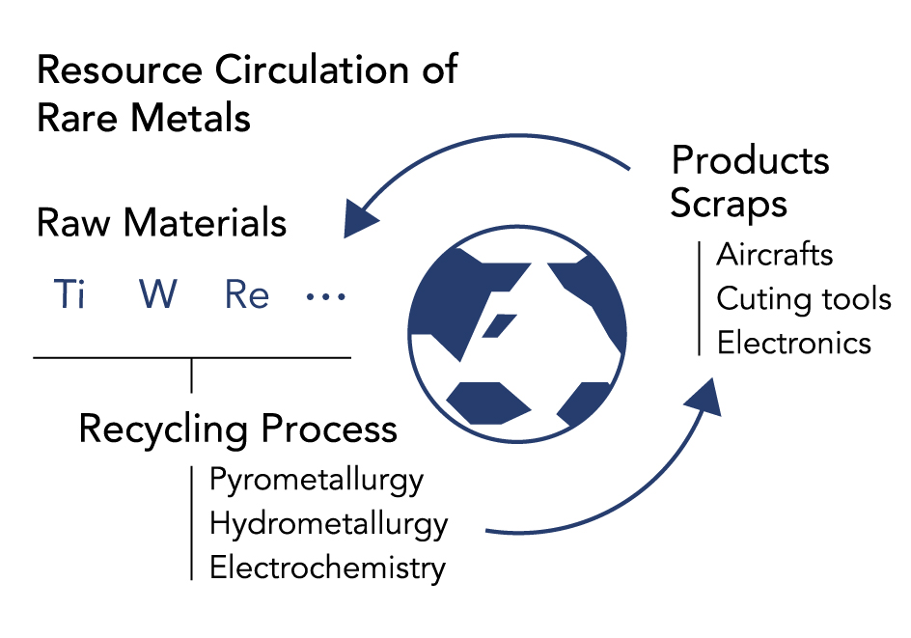
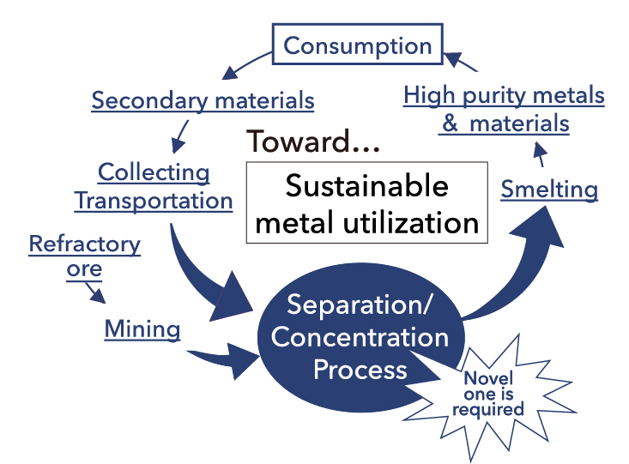
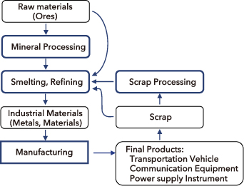
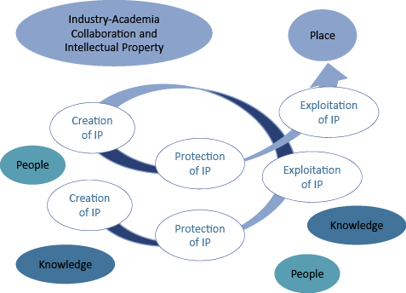
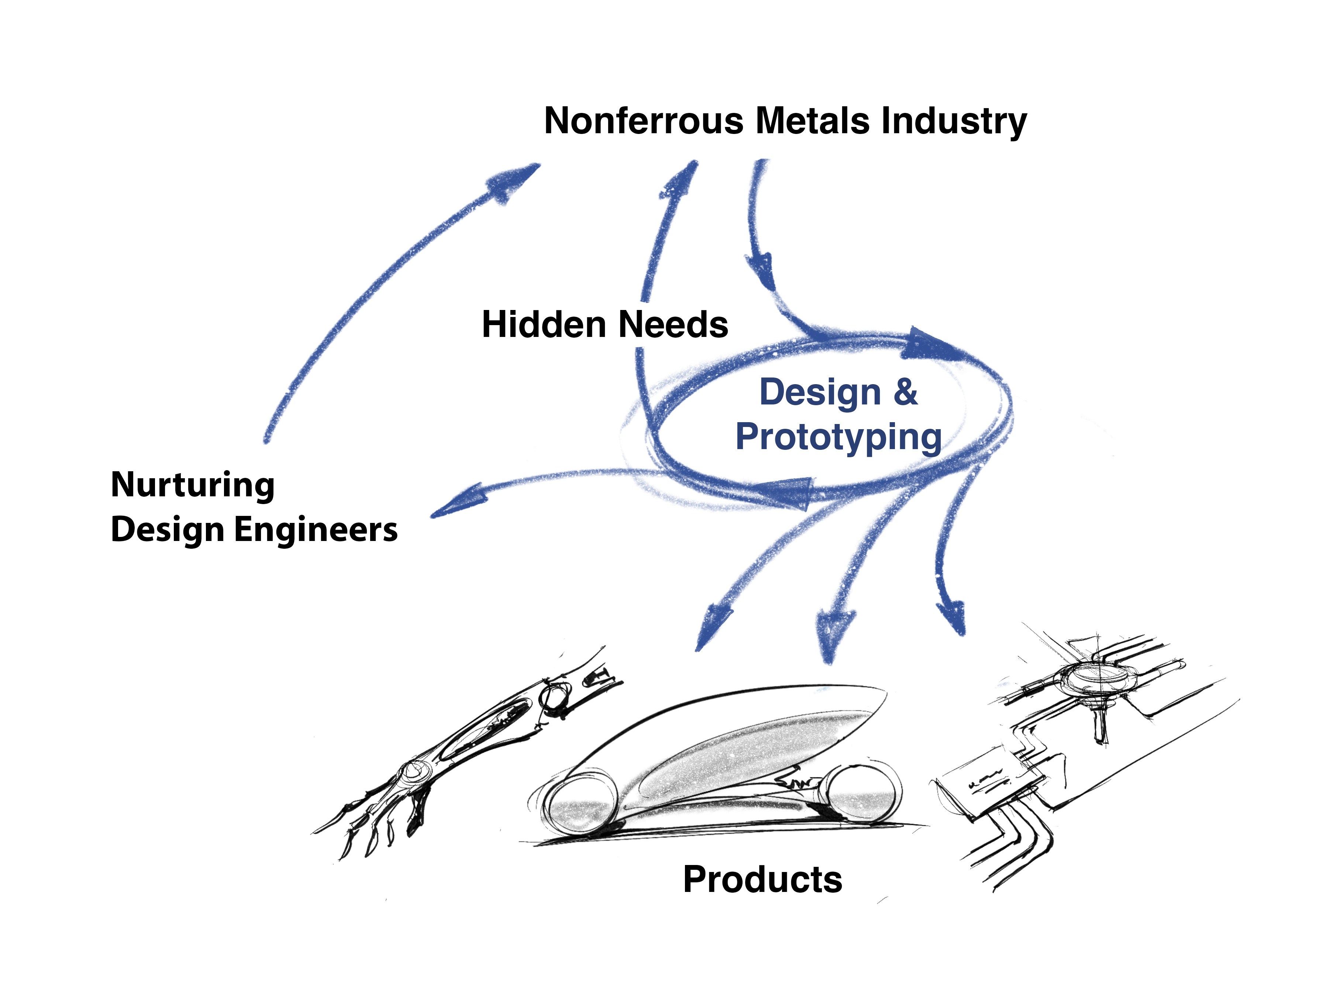
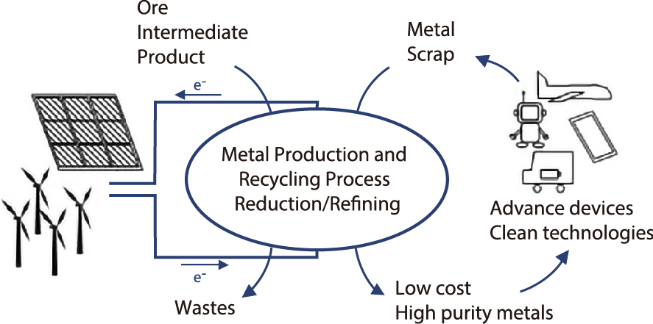
Recycling for Non-ferrous Metals and Rare Metals
Fw-401
Endowed Research Unit for
Non-ferrous Metals Resource Recovery Engineering
(JX Metals Endowed Unit)
[ Towards Highly Sustainable Society ]
Institute of Industrial Science, Endowed Chairs
Non-ferrous Metals Resource Recovery Engineering
http://www.metals-recycling.iis.u-tokyo.ac.jp/
Industry–University Collaboration Center
for Developing New Metal Recycling Processes
Sponsor: JX Metals Corporation
[ Period ]
1st period: January 2012 to December 2016 (5 years)
2nd period: January 2017 to December 2021 (5 years)
3rd period: January 2022 to December 2026 (5 years)
Recycling valuable materials is crucial for sustainable societal
development, with the depletion of high-quality natural resources and the rise of resource nationalism globally. In Japan, advancing
the recycling of both rare and base metals has become a vital issue.
This research unit focuses on developing innovative, environmentally harmonious recycling technologies for non-ferrous and rare metals using advanced smelting and refining techniques. It also collaborates with industry partners to nurture young researchers and engineers in this field.
In the second period, this unit advanced and strengthened the activities undertaken in the first period and spread awareness about the significance of this field among the general public, especially young generation (under high-school age) and their parents.
In the third period starting from January 2022, in addition to the past activities, we are developing newer activities focusing on SDGs and STEAM education.
Research Group
Developing New High-Efficiency Recycling Technologies for
Rare Metals
Development of Separation and Concentration Technologies
for Utilizing Waste and Refractory Ores as Resources
Optimization of Non-Ferrous Metal Smelting Processes
Project Prof.
Toru H. Okabe
Project Prof.
Chiharu Tokoro
Project Prof.
Harumasa
Kurokawa
Okabe laboratory is dedicated to developing innovative, high-efficiency, and environmentally sound recycling technologies for rare metals such as titanium, which is anticipated to see increased demand as a structural material; tungsten and cobalt, indispensable in tool materials; rhenium, which is used in nickel-based superalloys; and platinum group metals found in automotive exhaust catalysts.
Tokoro laboratory conducts research to achieve an energy-efficient separation and concentration process that focuses on solid/solid separation and concentration without melting down the waste and ores. This process acts as a crucial “pre-treatment” or “intermediate treatment” in the overall metallurgical or hydrometallurgical processes that produce high-purity metals.
Kurokawa Laboratory aims to achieve processes that are energy-efficient, environmentally sound, and cost-effective by minimizing energy consumption in production and maximizing the recovery of target metals to reduce waste generation.
Creating New Value from Intellectual Property for a Better
Future
Development of Non-Ferrous Metal Products and Next Generation Education Through Design Engineering
Development of High-Efficiency Metal Manufacturing and
Recycling Processes
Project Prof.
Tomoko Sugano
Project Prof.
Shunji
Yamanaka
Project Lecturer
Takanari Ouchi
Intellectual property (IP) plays a crucial role in the practical application of technologies and ideas in society. We explore effective methods for IP protection to facilitate societal implementation. Moreover, we leverage IP as a tool to generate new spaces for collaborative innovation. IP not only connects a diverse range of individuals but also fosters the creation of new knowledge and establishes novel platforms for interaction, thereby helping to shape a better future society.
Non-ferrous metals are indispensable materials for advanced devices and clean technologies. We are committed to new initiatives that demonstrate the value of non-ferrous metals to society at large through the design and prototyping of products utilizing these metals. At the same time, these projects serve as a platform for cultivating new breed of design engineers who possess both technical knowledge and a sense of aesthetics.
Ouchi Laboratory focuses on developing new methods for processing and recycling non-ferrous metals, guided by a commitment to achieving high-efficiency energy use and resource recycling. We strive to use energy more efficiently in transforming raw materials into metals, thereby helping to advance the state of the field. We are also innovating recycling processes to facilitate resource recycling, furthering our contribution to the creation of a sustainable society.

