Slide 1
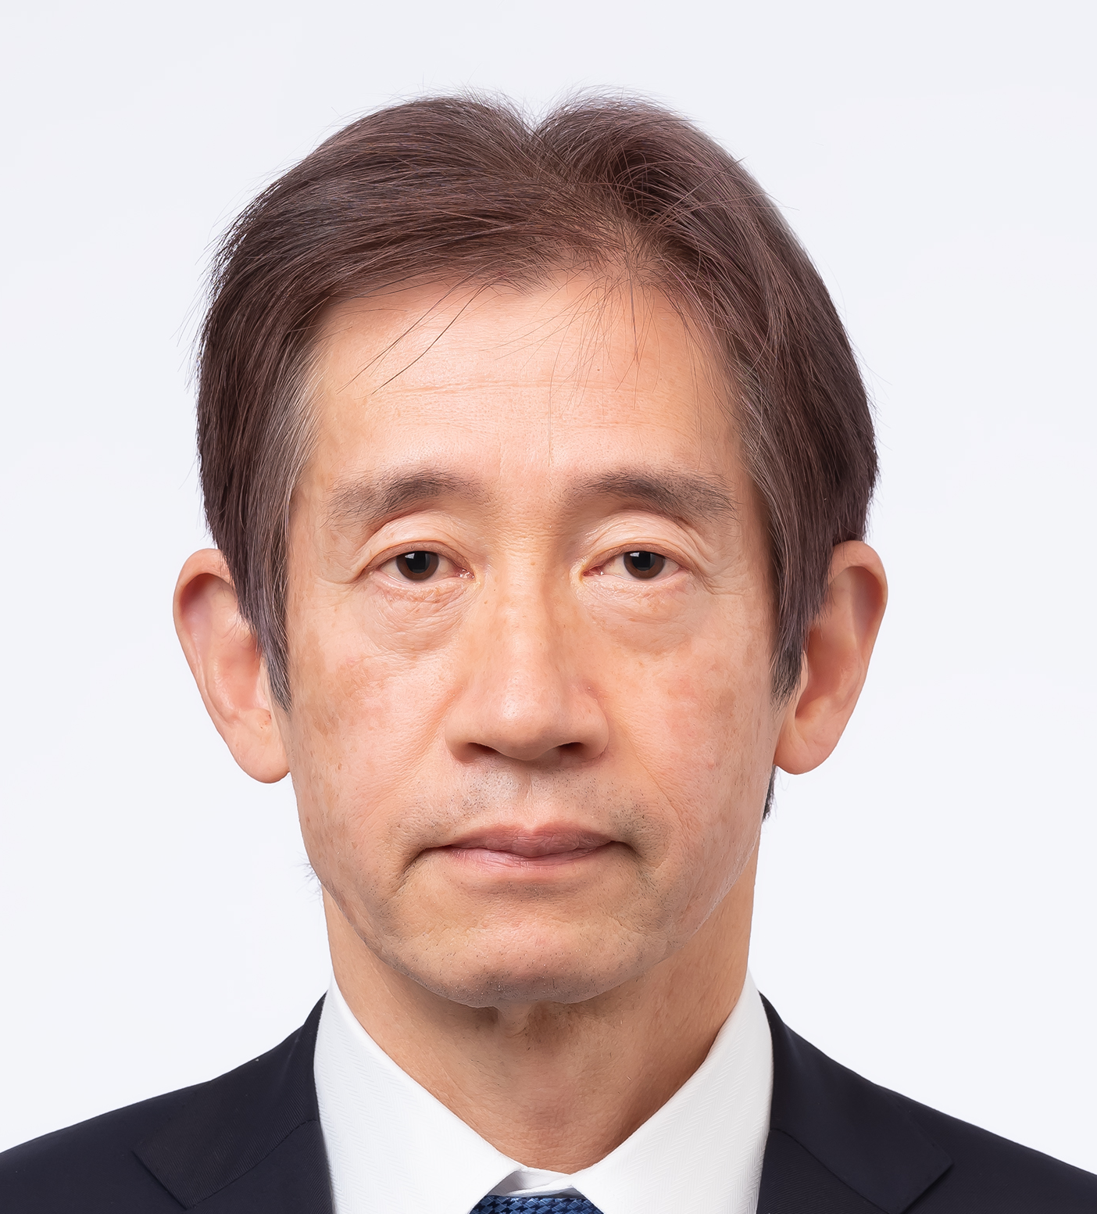
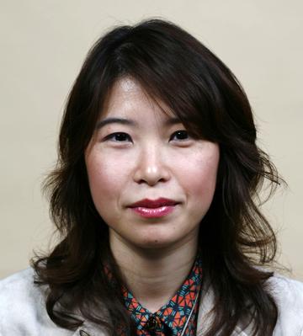
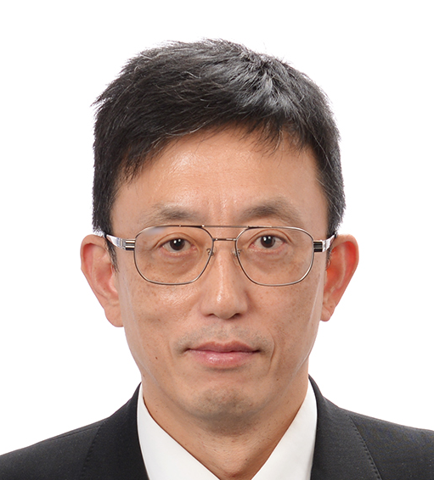
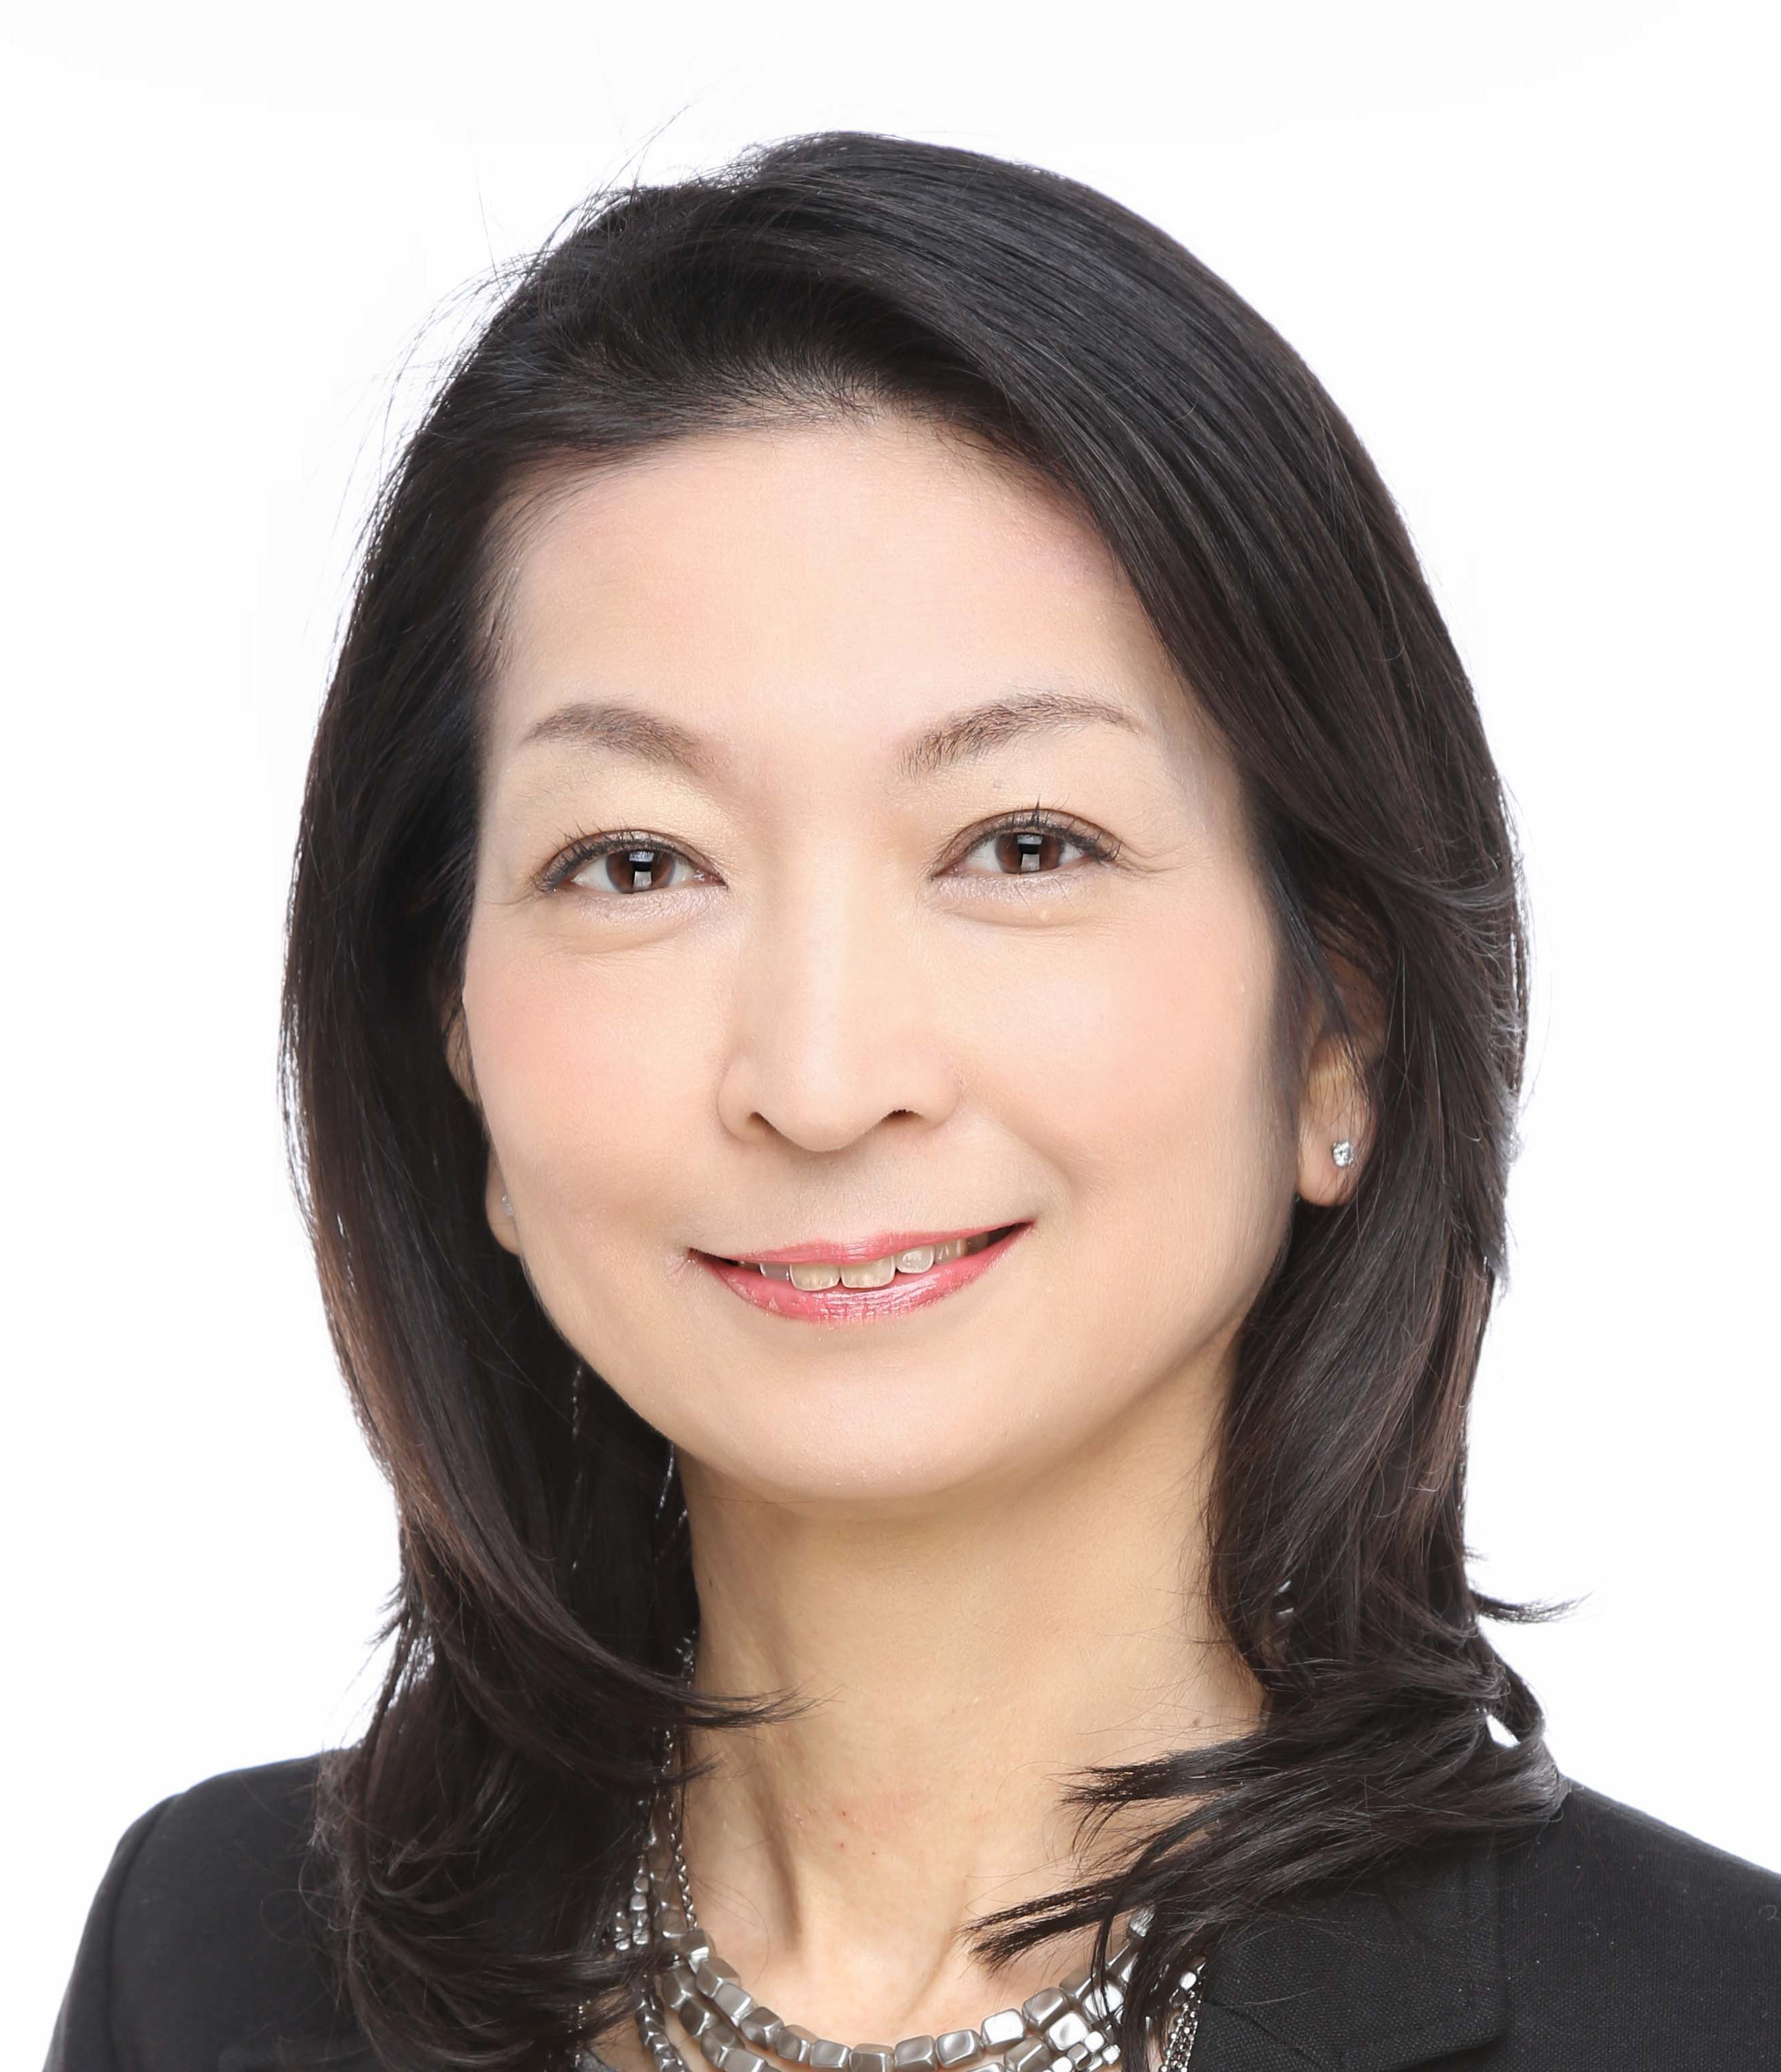
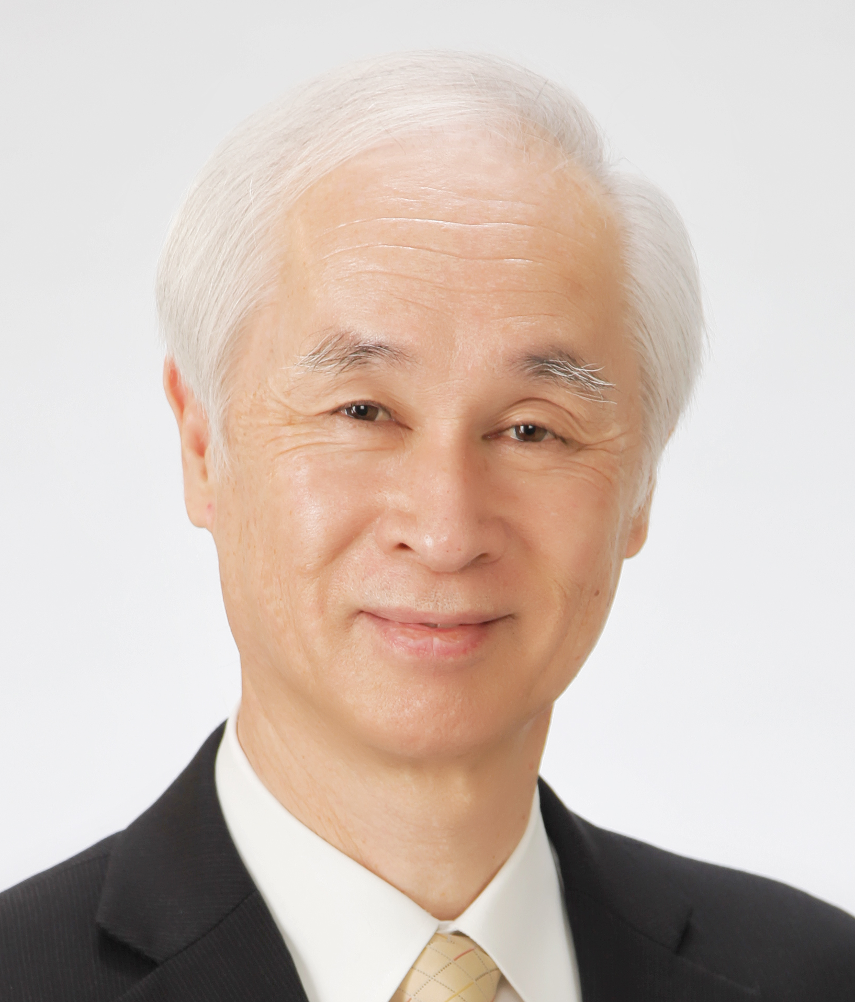
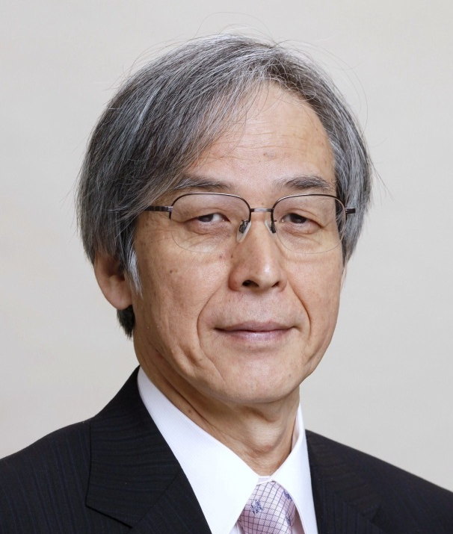
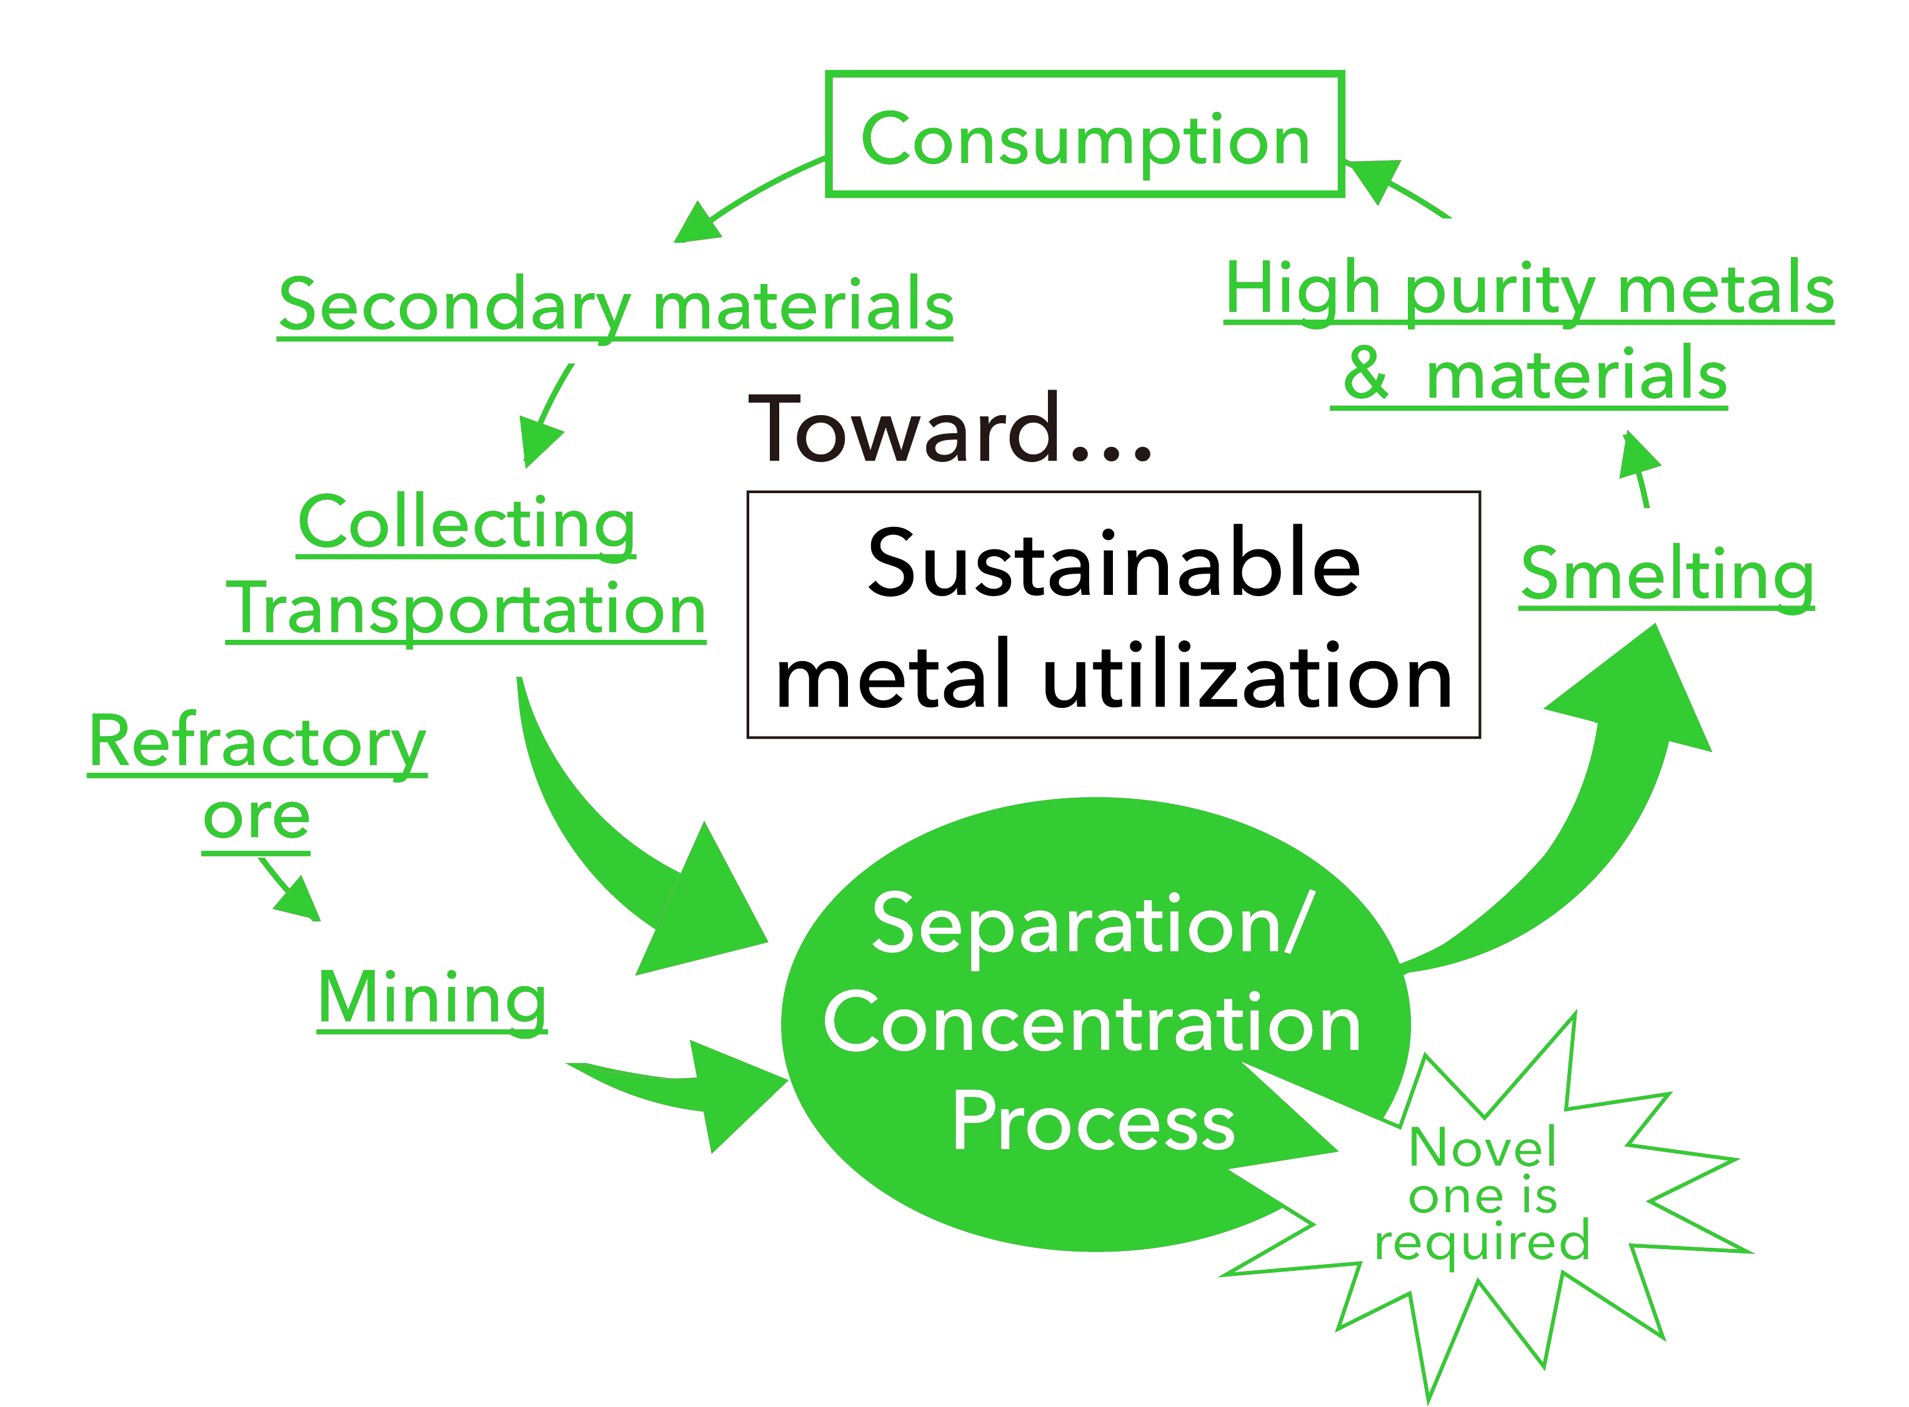
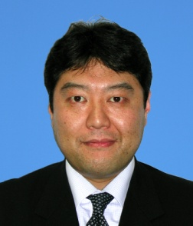
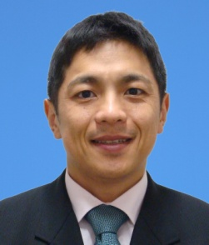
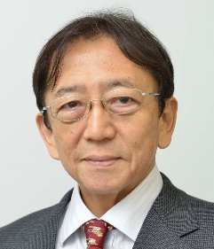
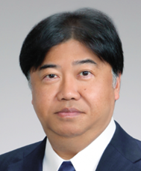
Recycling for Non-ferrous Metals and Rare Metals
Fw-401
Endowed Research Unit for
Non-ferrous Metals Resource Recovery Engineering
(JX Metals Endowed Unit)
[ Towards Highly Sustainable Society ]
Institute of Industrial Science, Endowed Chairs
Non-ferrous Metals Resource Recovery Engineering
http://www.metals-recycling.iis.u-tokyo.ac.jp/
Industry–University Collaboration Center
for Developing New Metal Recycling Processes
Sponsor: JX Nippon Mining & Metals Corporation
[ Period ]
1st period: January 2012 to December 2016（5 years）
2nd period: January 2017 to December 2021（5 years）
Recycling valuable materials is crucial for sustainable development. High-quality natural resources are being depleted, and resource nationalism is rising in countries with abundant natural resources. Therefore, it is imperative for Japanese society to promote the recycling of rare metals and base metals.
This unit develops environmentally friendly processes for recycling based on smelting and refining technologies for non-ferrous metals. Furthermore, in collaboration with industrial sectors, it aims to train young researchers and engineers in this field.
To further expand the activities of the unit after its first term of five years, the second term commenced in January 2017 with the inclusion of Prof. Chiharu Tokoro as a new member.
In the second term, this unit will not only advance the activities undertaken in the first term but also strengthen the activities to raise awareness of the significance of this field to the general public, especially young generation (below high-school age) and their parents.
Prof. Harumasa Kurokawa joined the unit in January 2021.
Research Group
Support Members
Project Prof.
Harumasa Kurokawa
Project Prof.
Chiharu Tokoro
Project Prof.
Toru H. Okabe
Professor,
Institute of Industrial Science,
The University of Tokyo
Advisor,
Sumitomo Metal Mining Co.,Ltd.
Professor,
Faculty of Science and Engineering,
Waseda University
Professor,
Graduate School of Engineering,
The University of Tokyo
Director General and Professor,
Institute of Industrial Science,
The University of Tokyo
Professor
Marie Oshima,
The University of Tokyo
Professor Emeritus
Takashi Nakamura,
Tohoku University
Developing Non-ferrous Metal Production Processes
Development of Separation and
Concentration Technology to Utilize Waste/Refractory Ore as “Resource”
Development of Efficient Recycling
Technologies for Rare Metals
Professor Emeritus
Masafumi Maeda,
The University of Tokyo
Professor
Shuji Owada
Waseda University
Research Fellow
Katsunori Yamaguchi
(Professor, Waseda University)
Research Fellow
Atsushi Shibayama
(Professor, Akita University)
Our laboratory develops energy-efficient, environmentally-sound, and low-cost process schemes to produce various non-ferrous metals by minimizing energy consumption and maximizing recovery ratio of target metals to reduce the amount of waste generation in the conventional processes .
Our laboratory explores solid–solid separation and concentration technology without heating or dissolving the waste or refractory ore to achieve an energy-efficient process. This process is considered “pre--treatment” or “middle treatment” before the metallurgical/hydrometallurgical process that produces high-purity metals.
Our laboratory is developing new, efficient, and environmentally sound processes to recycle rare metals such as titanium, tungsten, cobalt, rhenium, and platinum group metals, for which an increase in demand is expected.
Professor
Kazuki Morita,
The University of Tokyo
Project Professor
Takeo Hoshino,
The University of Tokyo

